Slide 1

#LifeKoKaroLift
Data Science Program
‹#›

Slide 2


Module Name: EDA & Statistics
Course : Statistics
Lecture On : Statistics - Day - 5
Instructor :
‹#›

Slide 3
Today’s Agenda
Revision
Binomial Distribution
Cumulative Distribution Function
Key Takeaways
Data Science Certification Program
‹#›

Slide 4

Revision
In previous session, we learnt about:
Permutations, Combinations
Probability: Definition and Properties
Types of Events
Rules of Probability - Addition and Multiplication
Random Variables, Expected Value
Probability Without Experiment

Slide 5
Binomial Distribution
Finding the probability without conducting an experiment means that we can find the probability using just pen and paper and with minimal effort.
A binomial distribution can be thought of as simply the probability of a SUCCESS or FAILURE outcome in an experiment or survey that is repeated multiple times.
The binomial is a type of distribution that has two possible outcomes
In other words, binomial distribution is applicable in situations where there are a fixed number of yes or no questions, with the probability of a yes or a no remaining the same in all the questions.
A coin toss has only two possible outcomes: heads or tails and taking a test could have two possible outcomes: pass or fail.

Slide 6
Binomial Distribution
The formula for finding binomial probability is given by:
P(X == r) = nCr * P^r * (1 – P)^(n – r)
where n is number of trials, p is probability of success and r is number of successes after n trials.
Binomial distributions must also meet the following three criteria:
The number of observations or trials is fixed at n.
Each trial is binary, i.e., it has only two possible outcomes: success or failure.
The probability of success is exactly the same from one trial to another.
Additional Reading: Binomial Distribution

Slide 7
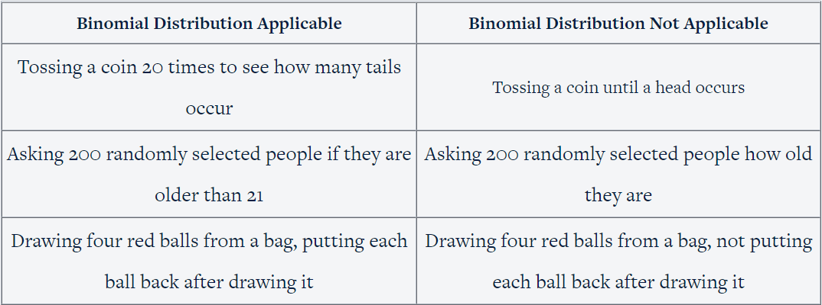
Binomial Distribution
Consider a few examples to understand these conditions in detail

Slide 8
Binomial Distribution
If you toss a coin 20 times to see how many times you get tails, you are following all the conditions required for a binomial distribution.
The total number of trials is fixed (20), and you can only have two outcomes, i.e., tails and heads. The probability of getting a tails is 0.5 each time you toss a coin.
In a way, this is similar to drawing 20 balls out of a bag, replacing each ball after drawing it, and seeing how many of the balls are red. Here, the probability of getting a red ball in one trial is 0.5.
When you toss a coin until you get a heads, the total number of trials is not fixed.
This is similar to taking out balls from the bag repeatedly until you draw a red ball.
You can still find the probability of getting heads in one trial, two trials, three trials, etc., but you cannot use the binomial distribution to find that probability.

Slide 9
Cumulative Probability
A cumulative probability refers to the probability that the value of a random variable falls within a specified range.
In the previous example, we only discussed the probability of getting an exact value.
Sometimes, talking in “less than” is more useful,
for example —> how many employees can get to work in less than 40 minutes.
Frequently, cumulative probabilities refer to the probability that a random variable is less than or equal to a specified value.
In mathematical terms, you would write cumulative probability F(x) = P(X<x).

Slide 10
Cumulative Probability
For Eg:
Consider a coin flip experiment.
If we flip a coin two times, we might ask: What is the probability that the coin flips would result in one or fewer heads?
The answer would be a cumulative probability.
It would be the probability that the coin flip results in zero heads plus the probability that the coin flip results in one head.
Thus, the cumulative probability would equal:
P(X < 1) = P(X = 0) + P(X = 1) = 0.25 + 0.50 = 0.75

Slide 11
Key Takeaway
Revision
Binomial Distribution
Cumulative Distribution Function
Key Takeaways
Data Science Certification Program
‹#›

Slide 12
#LifeKoKaroLift
Thank You!
‹#›

